Slide 1




AMAZON PRIME VIDEO
PRESENTATION
Presented by: YASH ANGRE

Slide 2
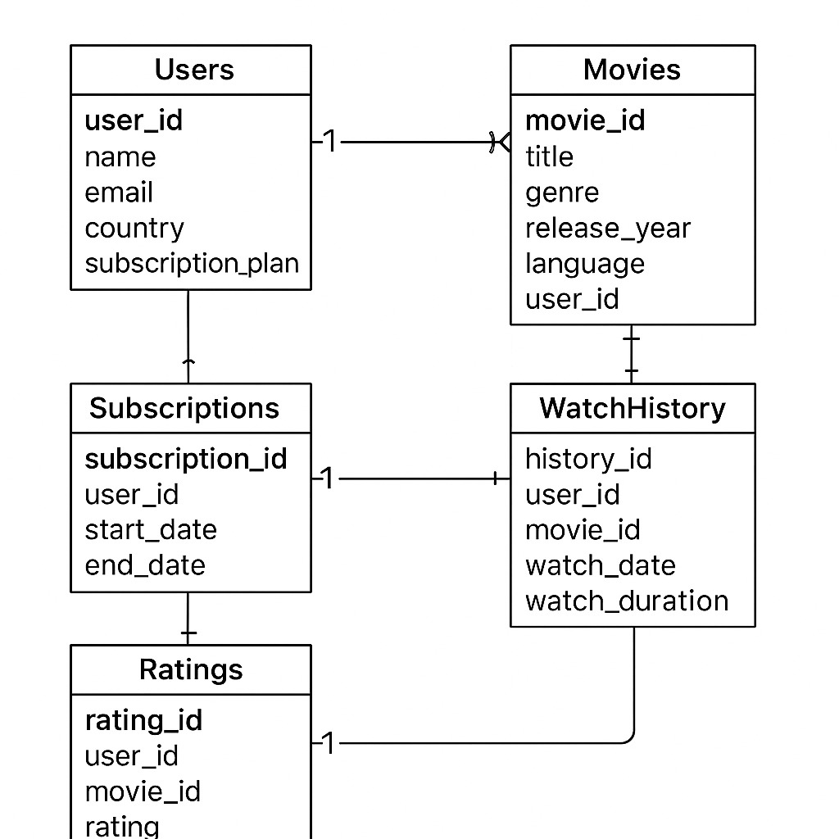

Slide 3

INTRODUCTION
“THIS PROJECT FOCUSES ON ANALYZING AMAZON PRIME VIDEO DATA TO EXPLORE USER BEHAVIOR, MOVIE TRENDS, AND SUBSCRIPTION INSIGHTS. BY USING SQL QUERIES, WE EXTRACT MEANINGFUL INFORMATION SUCH AS TOP-RATED MOVIES, MOST ACTIVE USERS, AND VIEWING PATTERNS. THE GOAL IS TO UNDERSTAND HOW DATA ANALYSIS CAN ENHANCE DECISION-MAKING IN DIGITAL STREAMING PLATFORMS.”

Slide 4
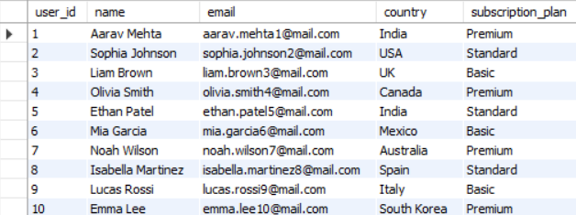
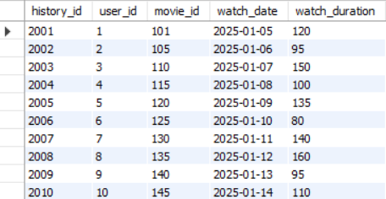
CONTENTS OF TABLE
1.SHOW ALL USERS
SELECT * FROM USERS;
2.SHOW ALL WATCH HISTORY
SELECT * FROM WATCHHISTORY;

Slide 5
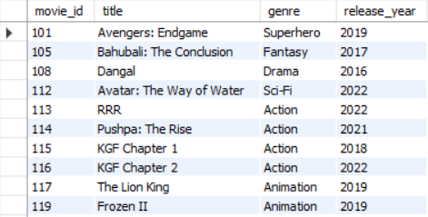
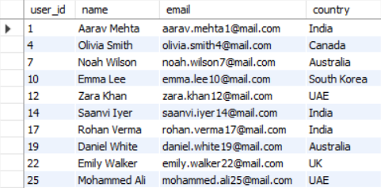
SUBQUERY
3.FIND MOVIES RELEASED AFTER 2015
SELECT MOVIE_ID, TITLE, GENRE, RELEASE_YEAR
FROM MOVIES
WHERE RELEASE_YEAR > 2015;
4.FIND ALL PREMIUM USERS
SELECT USER_ID, NAME, EMAIL, COUNTRY
FROM USERS
WHERE SUBSCRIPTION_PLAN = 'PREMIUM';

Slide 6
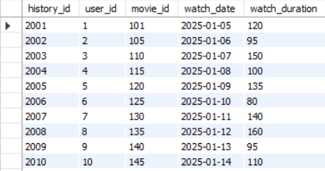
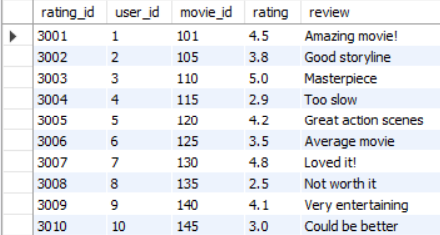
SUBQUERY
5.SHOW ALL WATCH HISTORY
SELECT * FROM WATCHHISTORY;
6.SHOW ALL RATINGS
SELECT * FROM RATINGS;

Slide 7
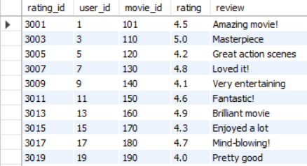
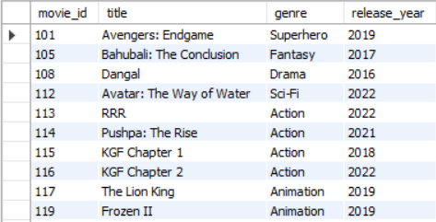
SUBQUERY
7.FIND ALL RATINGS ABOVE 4
SELECT * FROM RATINGS WHERE RATING >= 4.0;
8.FIND MOVIES RELEASED AFTER 2015
SELECT MOVIE_ID, TITLE, GENRE, RELEASE_YEAR
FROM MOVIES
WHERE RELEASE_YEAR > 2015;

Slide 8
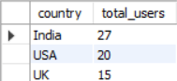
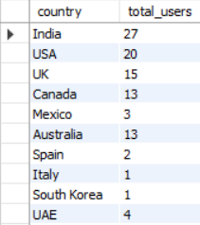
SUBQUERY
9.TOP 3 MOST ACTIVE COUNTRIES (USERS).
SELECT COUNTRY, COUNT(*) AS TOTAL_USERS
FROM USERS
GROUP BY COUNTRY
ORDER BY TOTAL_USERS DESC LIMIT 3;
10.COUNT USERS BY COUNTRY
SELECT COUNTRY, COUNT(*) AS TOTAL_USERS
FROM USERS
GROUP BY COUNTRY;

Slide 9
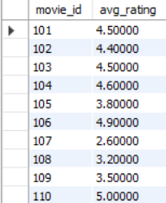
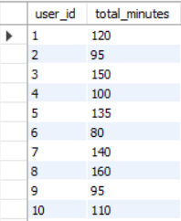
SUBQUERY
11.AVERAGE RATING OF EACH MOVIE
SELECT MOVIE_ID, AVG(RATING) AS AVG_RATING
FROM RATINGS
GROUP BY MOVIE_ID;
12.TOTAL WATCH DURATION PER USER
SELECT USER_ID, SUM(WATCH_DURATION) AS TOTAL_MINUTES
FROM WATCHHISTORY
GROUP BY USER_ID;

Slide 10
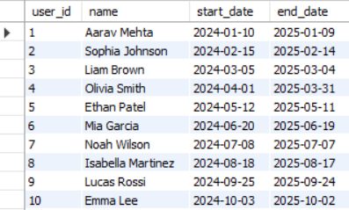
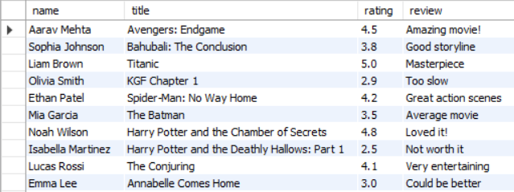
13.GET USER DETAILS WITH THEIR SUBSCRIPTIONS
SELECT U.USER_ID, U.NAME, S.START_DATE, S.END_DATE
FROM USERS U
JOIN SUBSCRIPTIONS S ON U.USER_ID = S.USER_ID;
14.SHOW USERS WITH MOVIES THEY RATED
SELECT U.NAME, M.TITLE, R.RATING, R.REVIEW
FROM RATINGS R
JOIN USERS U ON R.USER_ID = U.USER_ID
JOIN MOVIES M ON R.MOVIE_ID = M.MOVIE_ID;

Slide 11
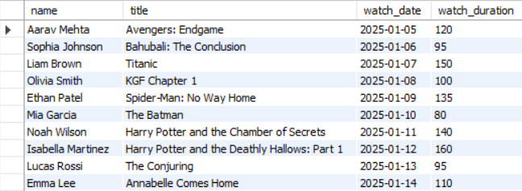
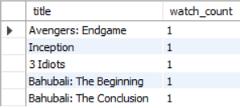
15.SHOW WATCH HISTORY WITH MOVIE NAMES
SELECT U.NAME, M.TITLE, W.WATCH_DATE, W.WATCH_DURATION
FROM WATCHHISTORY W
JOIN USERS U ON W.USER_ID = U.USER_ID
JOIN MOVIES M ON W.MOVIE_ID = M.MOVIE_ID;
16.TOP 5 MOST WATCHED MOVIES
SELECT M.TITLE, COUNT(W.HISTORY_ID) AS WATCH_COUNT
FROM WATCHHISTORY W
JOIN MOVIES M ON W.MOVIE_ID = M.MOVIE_ID
GROUP BY M.TITLE
ORDER BY WATCH_COUNT DESC
LIMIT 5;

Slide 12
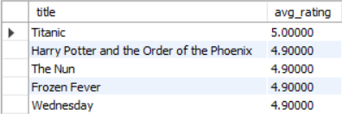

17.TOP 5 HIGHEST RATED MOVIES
SELECT M.TITLE, AVG(R.RATING) AS AVG_RATING
FROM RATINGS R
JOIN MOVIES M ON R.MOVIE_ID = M.MOVIE_ID
GROUP BY M.TITLE
ORDER BY AVG_RATING DESC
LIMIT 5;
18.USERS WHO HAVE WATCHED MORE THAN 2 MOVIES
SELECT USER_ID, COUNT(HISTORY_ID) AS MOVIES_WATCHED
FROM WATCHHISTORY
GROUP BY USER_ID
HAVING COUNT(HISTORY_ID) > 2;

Slide 13
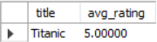
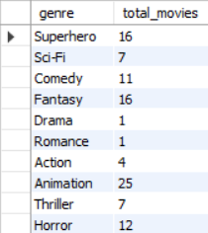
19.SHOW HIGHEST-RATED MOVIE WITH ITS TITLE:
SELECT M.TITLE, AVG(R.RATING) AS AVG_RATING
FROM MOVIES M
JOIN RATINGS R ON M.MOVIE_ID = R.MOVIE_ID
GROUP BY M.TITLE
ORDER BY AVG_RATING DESC
LIMIT 1;
20.FIND NUMBER OF MOVIES PER GENRE:
SELECT GENRE, COUNT(*) AS TOTAL_MOVIES
FROM MOVIES
GROUP BY GENRE;

Slide 14
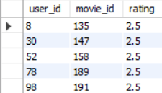
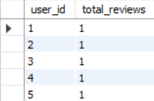
21.FIND USERS WHO GAVE THE LOWEST RATING OVERALL
SELECT USER_ID, MOVIE_ID, RATING
FROM RATINGS
WHERE RATING = (SELECT MIN(RATING) FROM RATINGS);
22.FIND TOP 5 USERS WHO REVIEWED THE MOST MOVIES
SELECT USER_ID, COUNT(*) AS TOTAL_REVIEWS
FROM RATINGS
GROUP BY USER_ID
ORDER BY TOTAL_REVIEWS DESC
LIMIT 5;

Slide 15
THANK YOU

